Slide 1

UConn Health Waterbury Hospital Community Health Needs Assessment Public Hearing
September 17th, 2026
4PM - 6PM

Slide 2

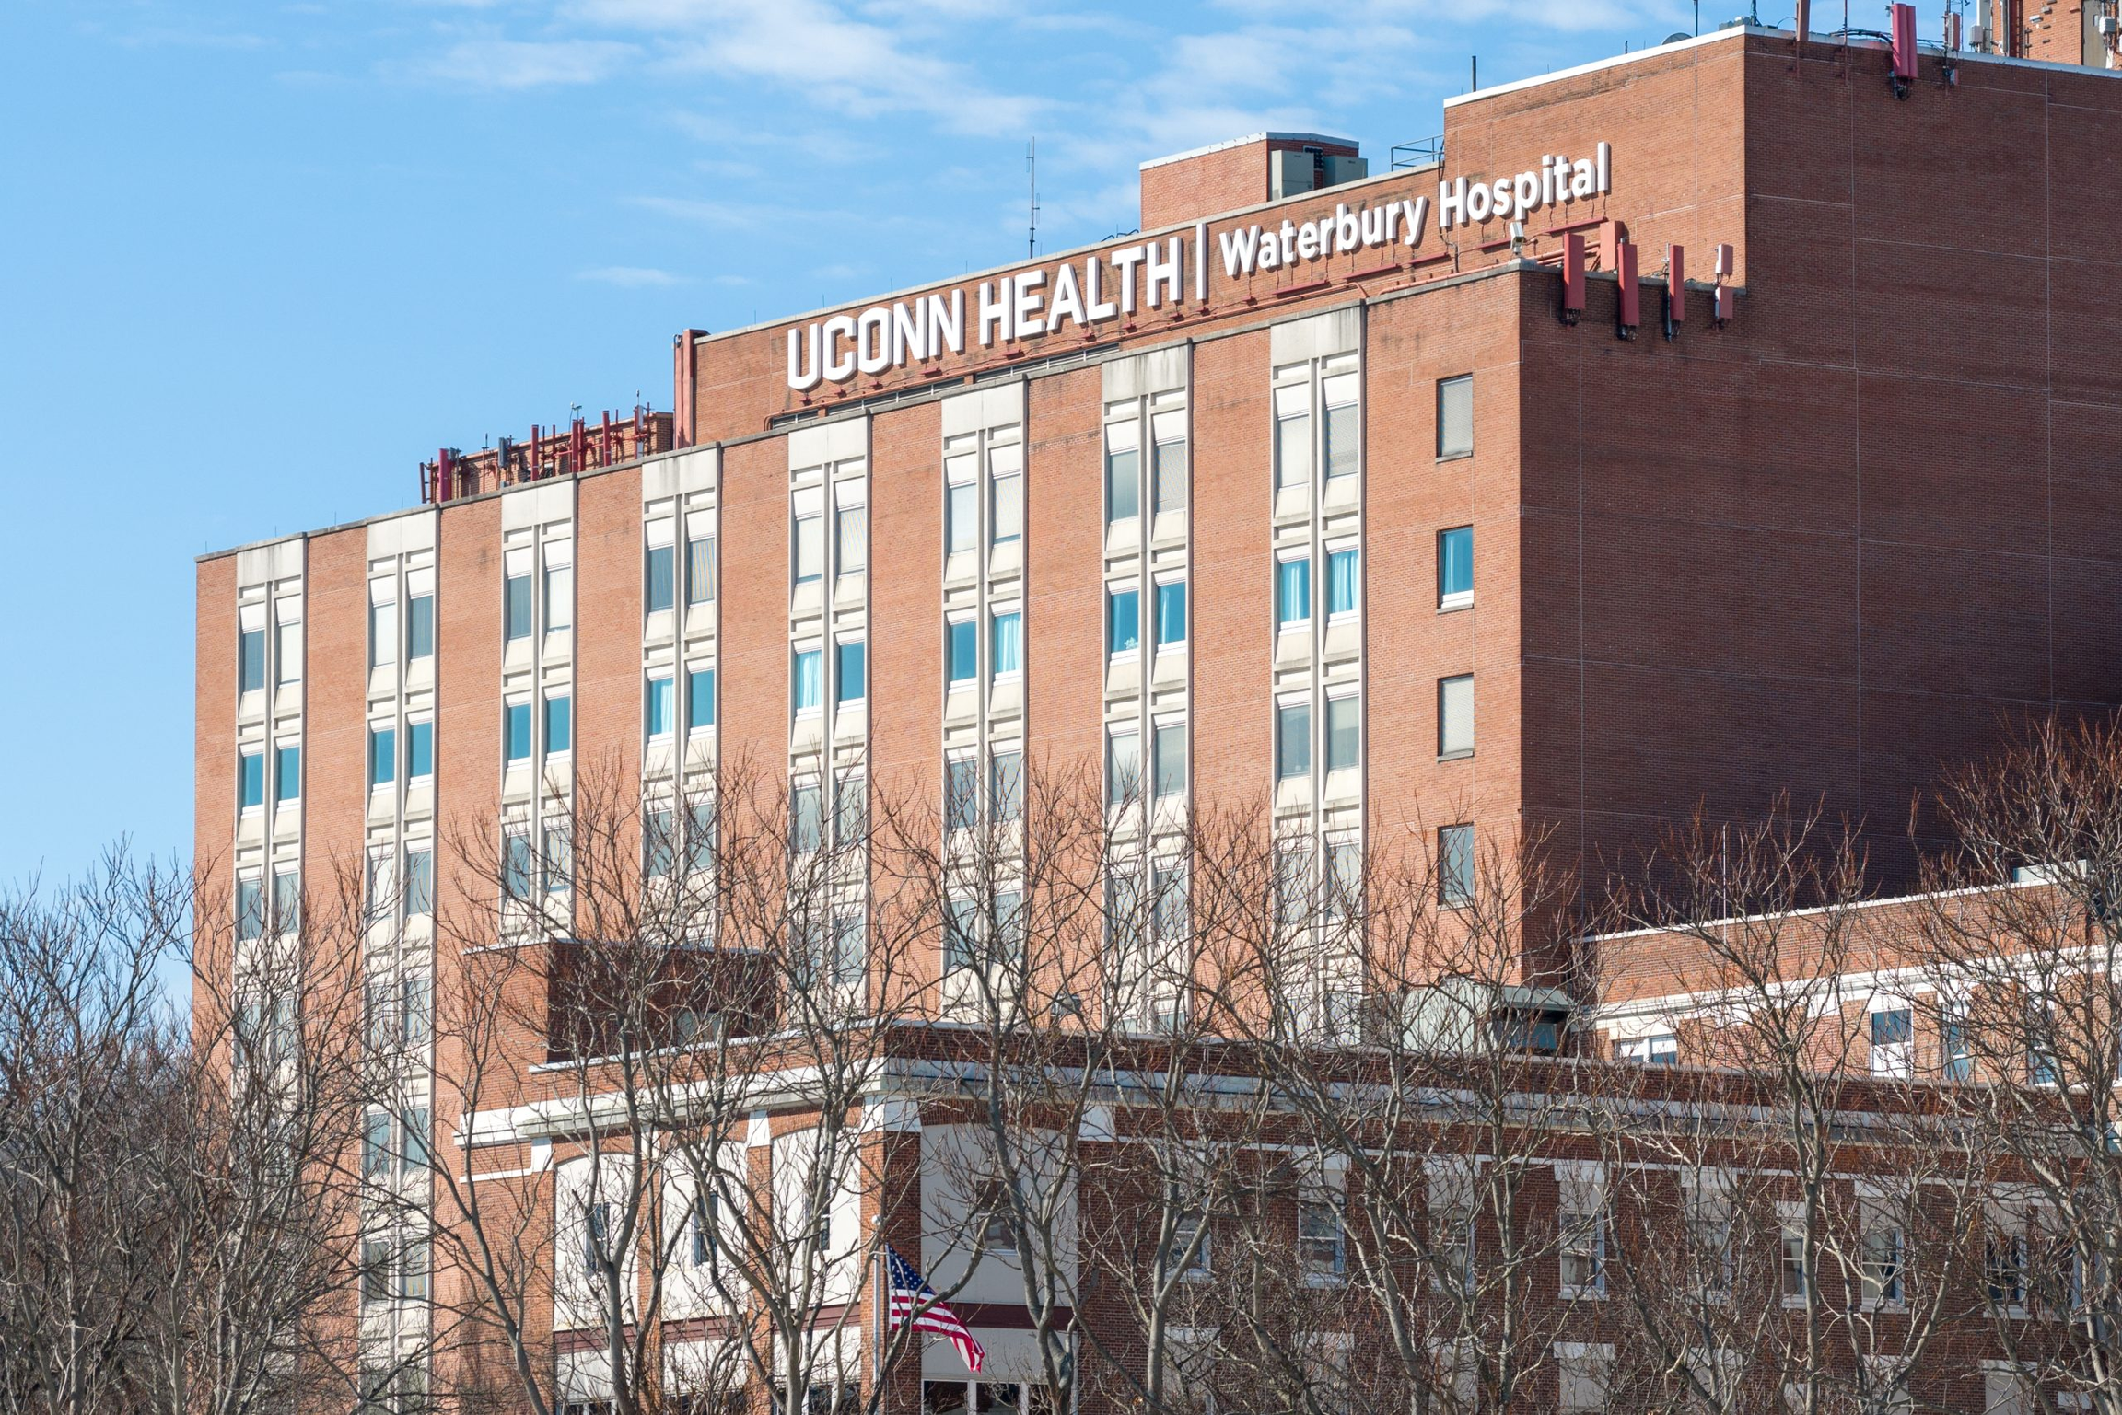
Quality
Compassion
Access
Community
Equitable
6 MONTHS
Since March 1st, UConn Health Waterbury Hospital has continued building a legacy of compassionate, high-quality care for Greater Waterbury.
This partnership has strengthened access to services, connected our employees to academic medicine and research, and reinforced our commitment to equity, excellence, and accountability to the patients we serve.
Same focus: keeping trusted, quality care close to home available for generations to come.
March - September 2026

Slide 3
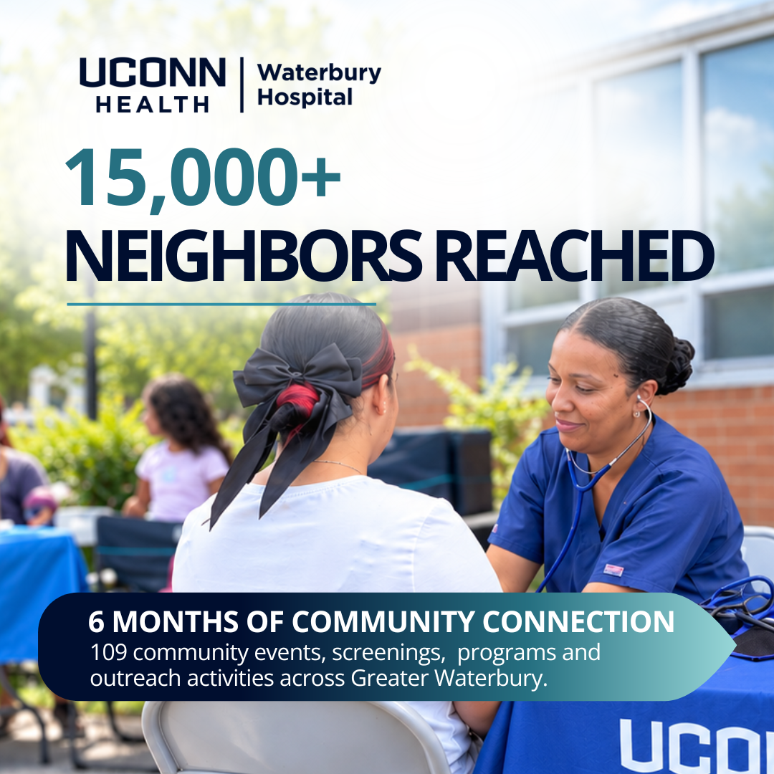

Quality and Safety our 1st Priority

Slide 4


More Care Closer to Home

Slide 5

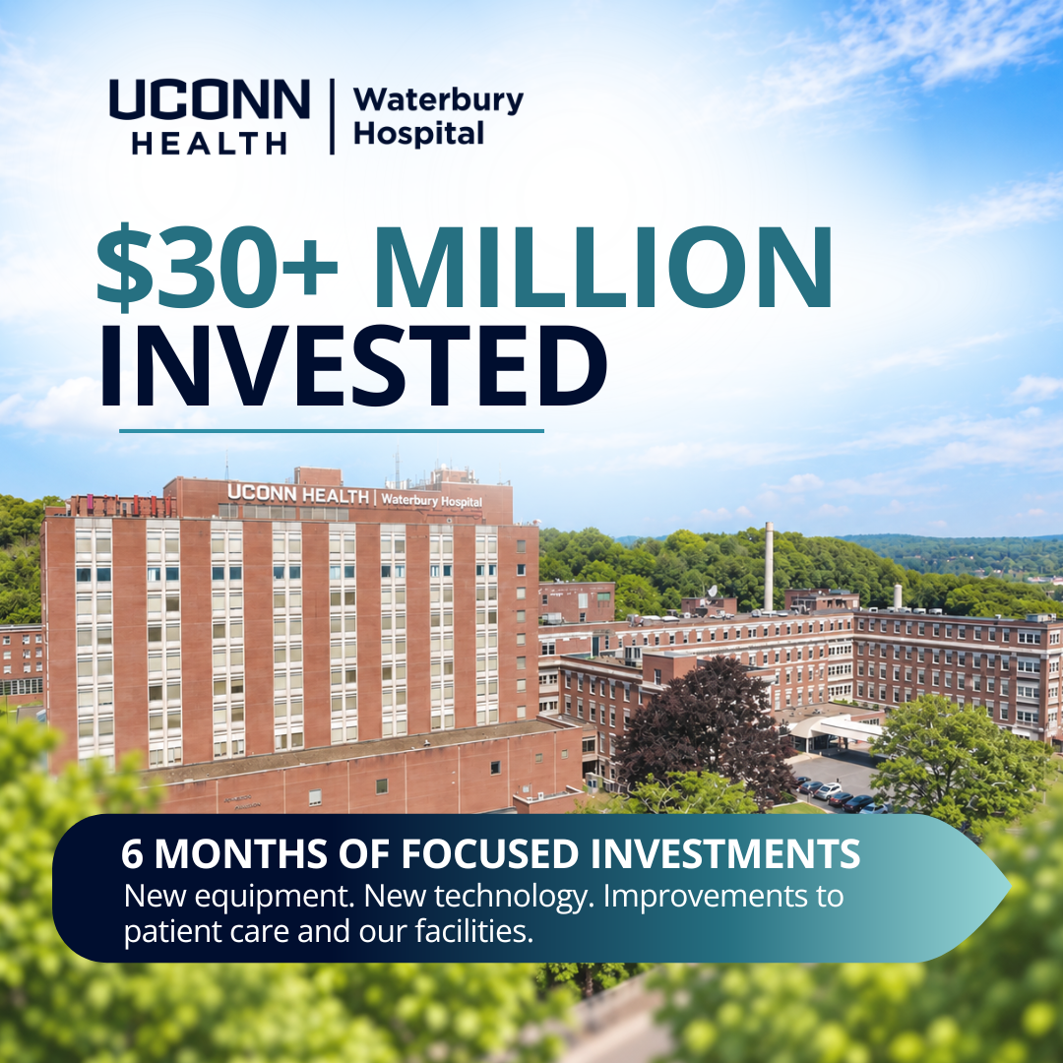
Investing in the Future

Slide 6
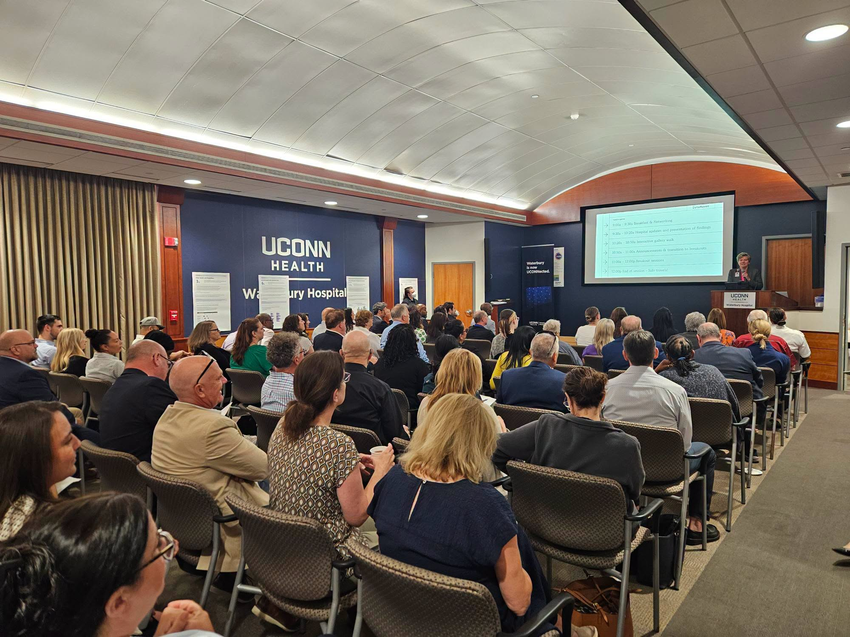
Quality
Compassion
Access
Community
Equitable
CHNA
Work began almost immediately after the transition to UConn Health Waterbury Hospital.
Our Work so far:
12 Focus Groups in Greater Waterbury including 3 in Spanish
Key Informant Meeting with 100 community leaders from over 50 different organizations
Goal: Finalized CHNA by end of 2026

Slide 7
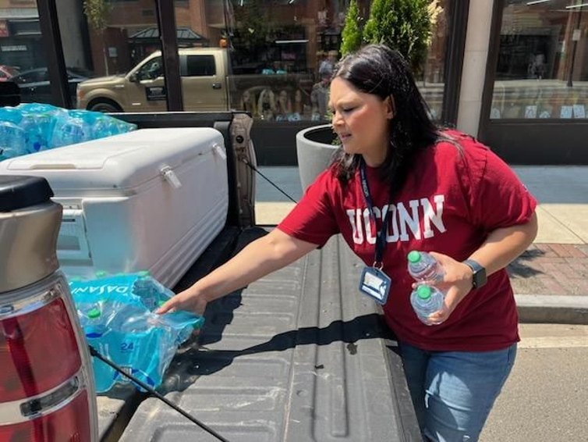
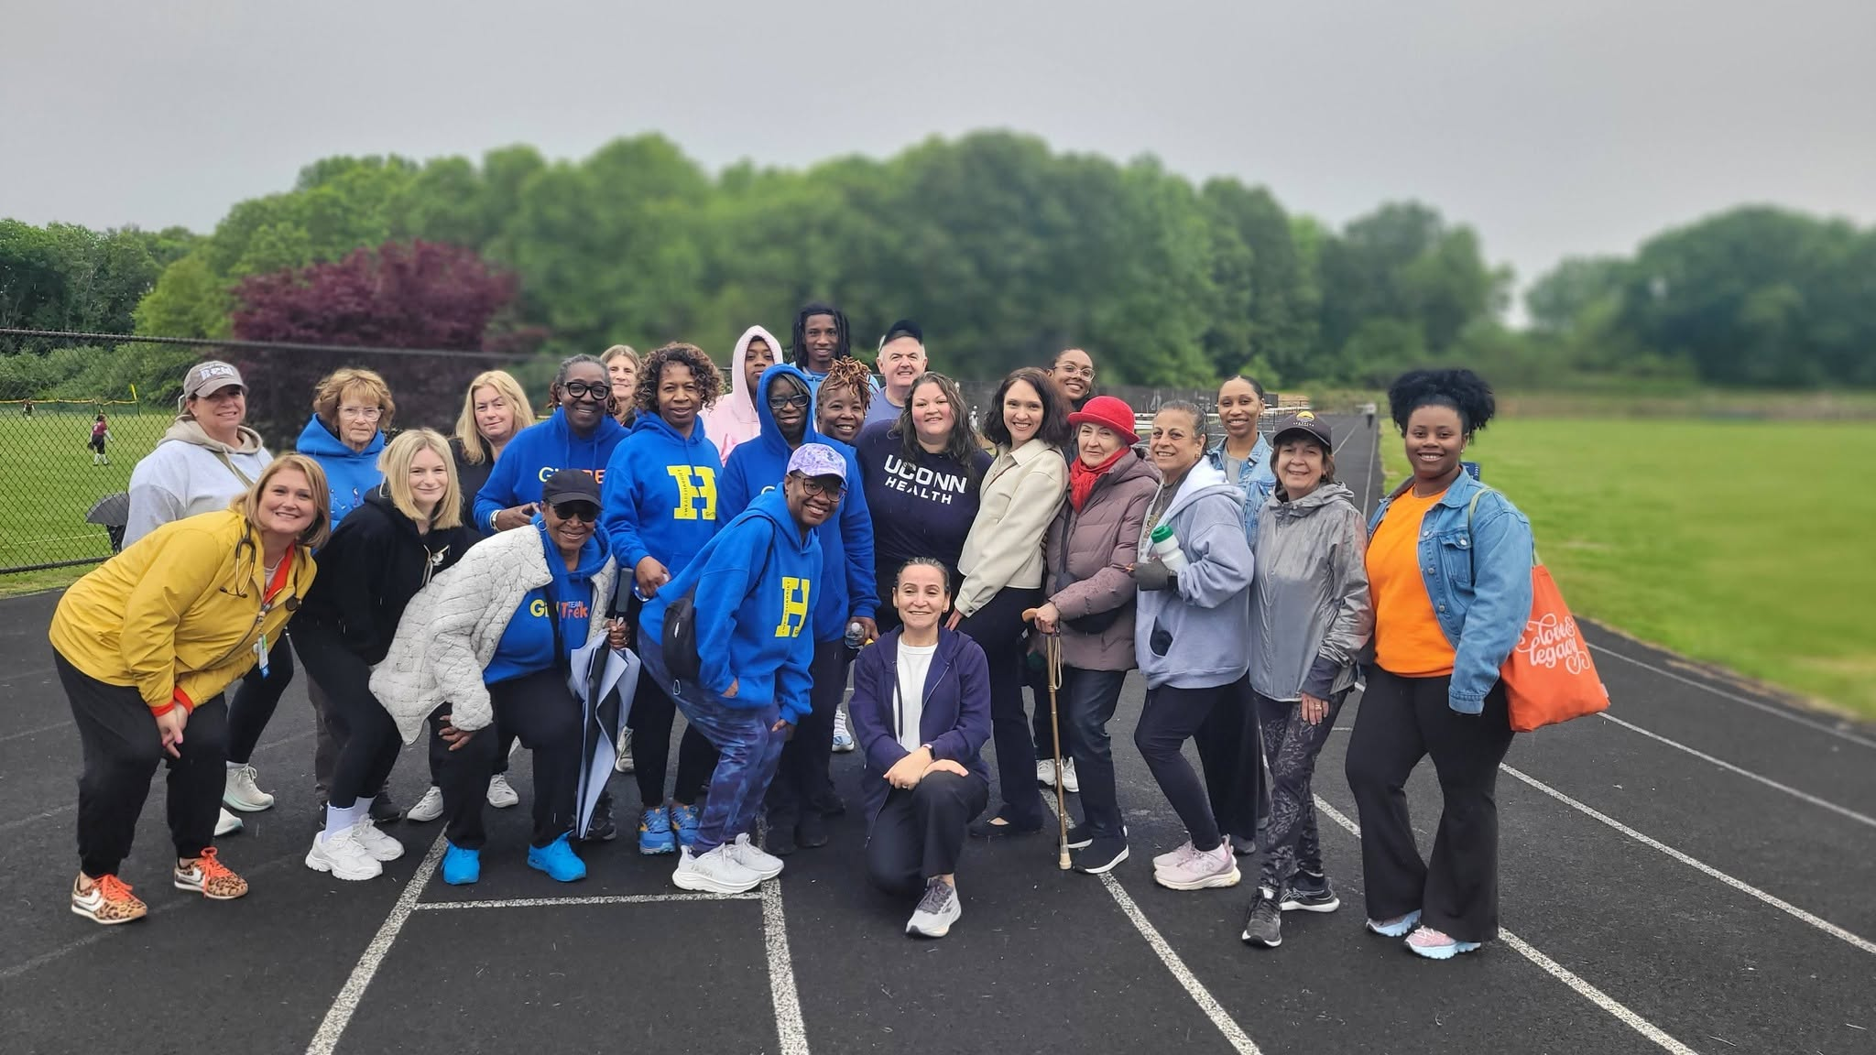
Key Priorities
Prioritization Process: UConn Health Waterbury Hospital leaders reviewed research and data collected during the process, including feedback from focus groups and key informants, along with quantitative data compiled from various reports, including the Wellbeing Survey and the Waterbury Equity Report. This data highlighted community strengths, needs, service gaps, and opportunities. From a robust list of key findings, the team identified areas where the hospital could make the most immediate impact, the greatest overall impact, and lasting change.
Major Key Priority Categories:
Access to Health Care
Emergency Department Experience and Patient Support
Community Outreach and Health Equity
*We are currently finalizing priorities and multiple subcategories covering multiple programs and initiatives.

Slide 8
Thank you to the 2026 focus group host sites!
Waterbury City Hall/Neighborhood Association Leaders
NEST
UConn Waterbury
Hispanic Coalition of Greater Waterbury
Bridge to Success
Naugatuck Senior Center
Early Start Waterbury
LEAD Waterbury
UConn Health Waterbury Hospital
Center for Renewal
Oakville Woodview Apartments
Madre Latina
Community Health Needs Assessment 2026

Slide 9
Key themes from 2026 focus groups
Access to high-quality, affordable health care*
Affordability, cost of living and economic security*
Equity, discrimination, immigration and language access
Neighborhood environment, safety and infrastructure*
Services and support for children, youth and families*
Affordable, stable housing and homelessness
Mental health and substance use*
Transportation access and quality
Information, communication and health literacy
Older adults and disabilities*
Other issues
Community assets
Community Health Needs Assessment 2026

Slide 10
Study Methods
Notes:
Carter introduces gallery walk activity

Slide 11
Qualitative Methodology
Community Health Needs Assessment 2026
UConn Waterbury partnered with organizations throughout Waterbury representing a diverse population of clients, participants and stakeholders
Partner organizations recruited participants for 12 focus groups
Each focus group had one facilitator and notetaker from DataHaven and at least one representative from UConn Waterbury
Focus groups lasted between 60 and 120 minutes
Groups were asked about their community’s most pressing health needs
Focus Groups
✓
May
Focus groups began in May and continued through June
9 focus groups were conducted in English and 3 in Spanish
June
✓
Focus groups sessions prioritized diverse population voices from across Waterbury
July
Focus group summary, response from key stakeholders
✓
Community meeting and final report released
Fall
(TBD)

Slide 12
Quantitative Data Review
Community Health Needs Assessment 2026
DataHaven reviewed secondary data from a wide range of high-quality data sources:
DataHaven Community Wellbeing Survey - in-depth interviews with 6,169 randomly-selected adults in the region from 2015 through 2025, including 2,281 randomly-selected adults in Waterbury
  This survey will be repeated again in 2027, additional partners are welcome!
U.S. Census and other national datasets - trends in demographics, income, housing, etc.
Data from state agencies such as CTDPH, CTOPM, CTSDE - e.g., health, safety, financial, and education data
Quantitative Data
✓
Gather existing quantitative data sources
May
June
✓
Data analysis, create tables and charts
Present data in final report
Fall
(TBD)
ctdatahaven.org/report/datahaven-community-wellbeing-survey/

Slide 13
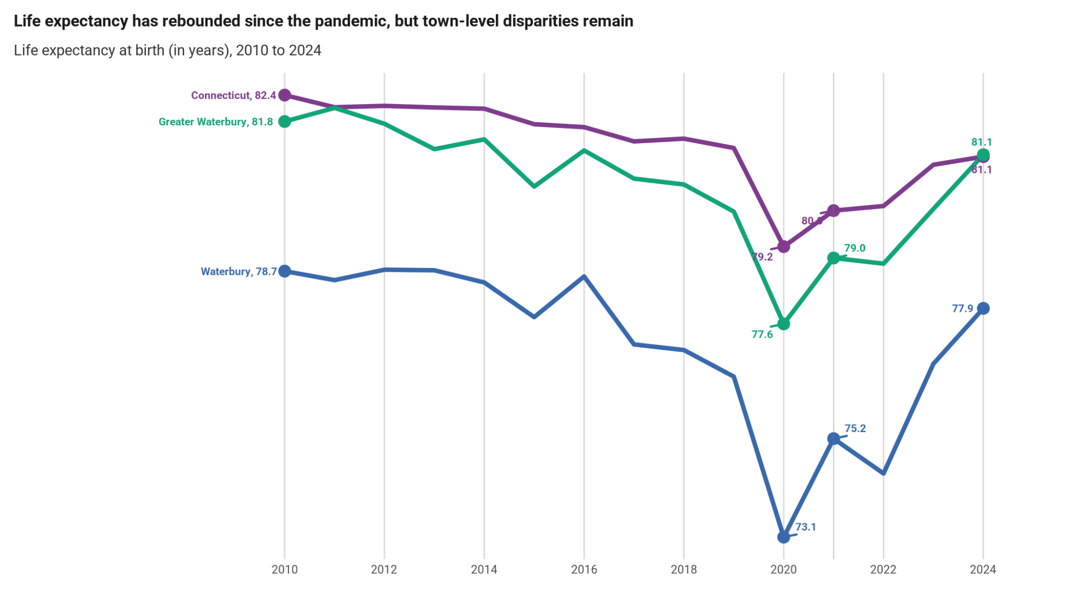
Example of Quantitative Data - Life Expectancy
During the pandemic, life expectancy dropped by ~6 years in Waterbury, compared to a drop of ~3 years in CT as a whole
Life expectancy (2024) by race/ethnicity in Greater Waterbury:
  Asian: 86
  White: 82
  Latino: 79
  Black: 75
Source: DataHaven (2026) analysis of CTDPH mortality records

Slide 14
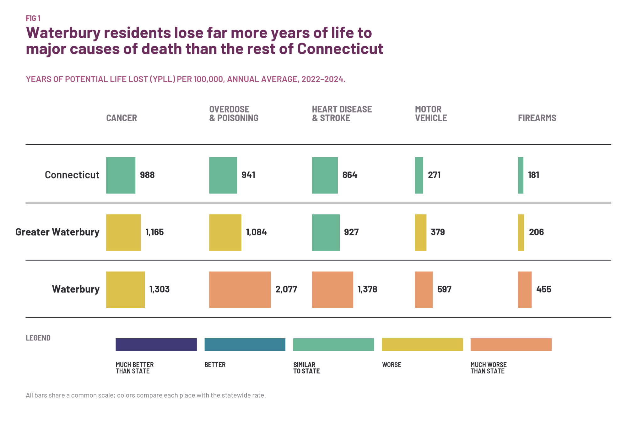
Example of Quantitative Data - Mortality
Major reasons for these large differences in life expectancy:
Drug overdoses
Cardiovascular diseases
Motor vehicle crashes
Firearm injuries
Source: DataHaven (2026) analysis of CTDPH mortality records

Slide 15
Study Results by Topic
Notes:
Carter introduces gallery walk activity

Slide 16
Access to high-quality, affordable health care
The most discussed topic
Traveling outside of Waterbury for quality care
Difficulty receiving timely care across emergency, primary and specialty care
Feeling “treated as a number”
High costs restricted care access especially for (un)derinsured participants
“[E]ven if I’m on my last shred of life, get me a car because I can’t afford an ambulance.”
“Emergency rooms are unfair. I was next in line, but I waited there for 13 hours because ambulances kept coming in.”

Slide 17
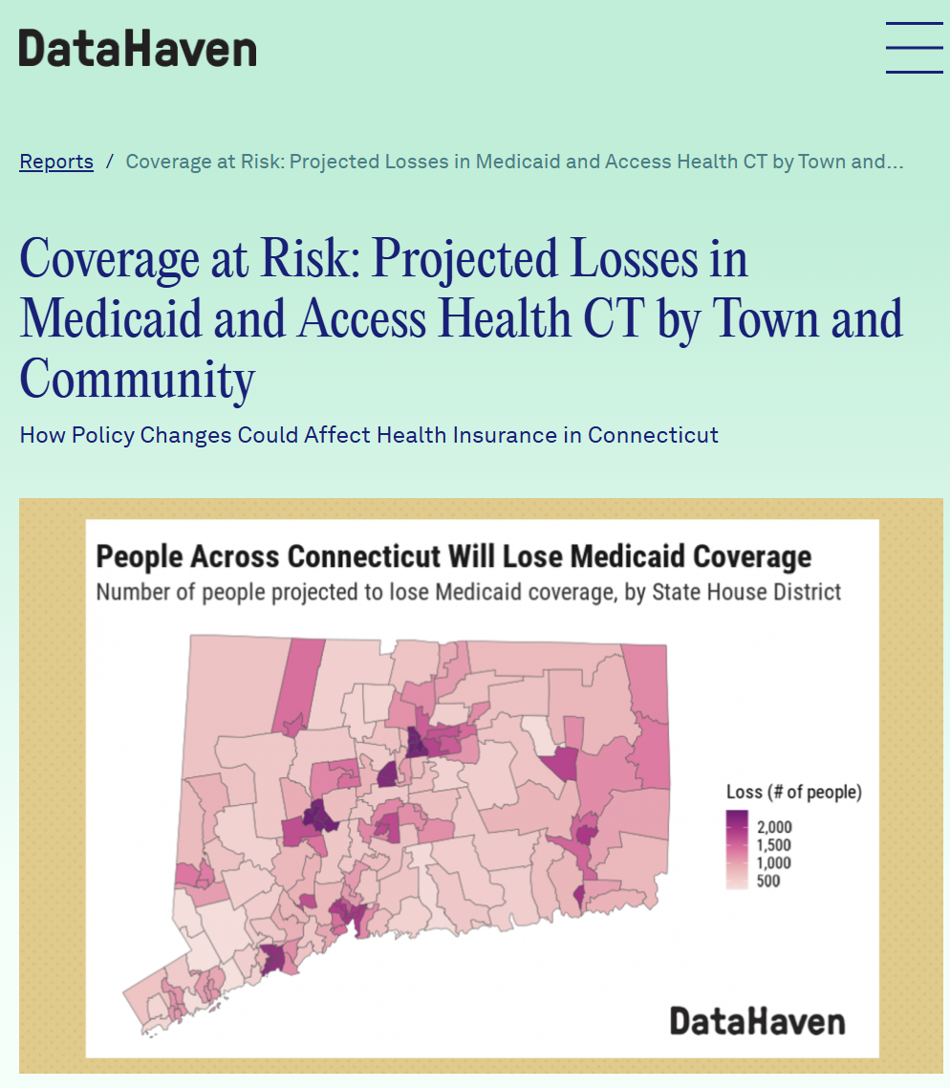
Access to high-quality, affordable health care
In the City of Waterbury, 11,000 people (about 10% of the city population) is projected to lose their Medicaid coverage due to H.R.1 impacts
28,000 people projected to lose Medicaid in the five State Senate Districts in and around Waterbury

Slide 18
The cost of living has risen
Affordability, cost of living and economic security
The cost of basic needs outpaces incomes
High costs require choices that harm health
A “benefits cliff” impacts working families
Food insecurity has long term implications for health
Food resources struggle to keep up with need
“Wages have not gone up in years while rent, food prices have doubled, tripled.”
“I am managing on my social security. This week I might have to eat hot dogs instead of steak.”

Slide 19
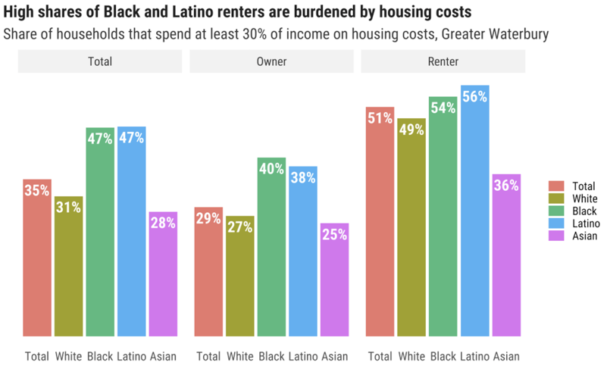
Affordability, cost of living and economic security
Source: DataHaven (2026) analysis of 2024 5-year U.S. Census ACS data

Slide 20
The built environment impacts experiences
Neighborhood environment, safety, and infrastructure
Old infrastructure makes water access unreliable
Blight is unsafe and a source of shame
Walkability is harmed by inadequate infrastructure and upkeep
Crime deters people from accessing outdoor resources
“There is a lack of stability when it comes to water use... We don’t know if the water we use to cook, to bathe ourselves, etc. is healthy.”
“Aquí en Waterbury, hay personas tirando basura, calles sucias, agua sucia...es feo.” [Here in Waterbury, people throw trash everywhere, streets are dirty, water is dirty...it’s awful.]

Slide 21
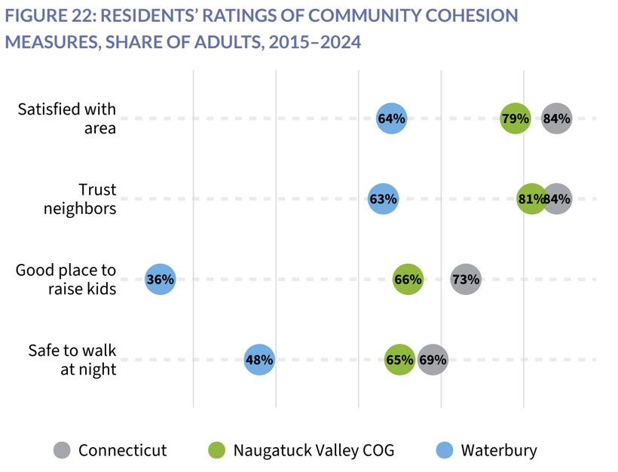
Neighborhood environment, safety, and infrastructure
In the 2024 DataHaven Community Wellbeing Survey, 46% of Waterbury adults said that the public parks in their area are in good condition, compared to 71% of adults statewide
Source: DataHaven (2026), Waterbury Town Equity Report, available at ctdatahaven.org

Slide 22
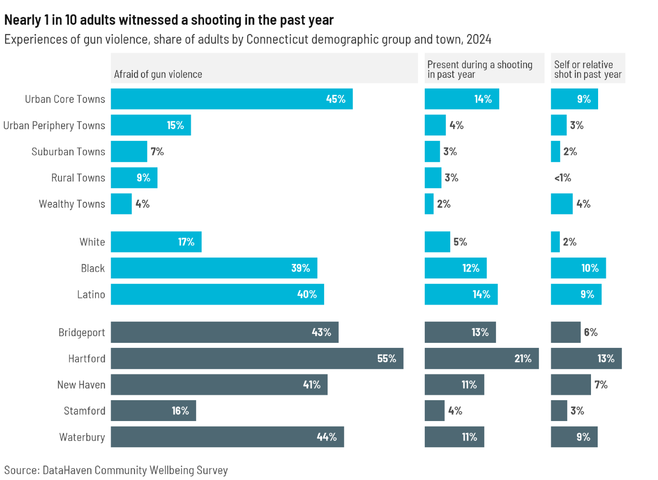
Neighborhood environment, safety, and infrastructure
In the 2024 DataHaven Community Wellbeing Survey, 44% of Waterbury adults are afraid that they or someone in their family will be hurt by gun violence in their neighborhood, compared to 7% of adults in suburban CT towns

Slide 23
Services and support for children, youth, and families
Limited resources to support families
Childcare is costly and scarce
Lack of local pediatric healthcare
Vaping and social media harm youth mental health
Inadequate support available for high risk pregnancies
“It’s so common in middle school and high school for kids to have vapes.”
“We need better programs and resources for autistic children.”

Slide 24
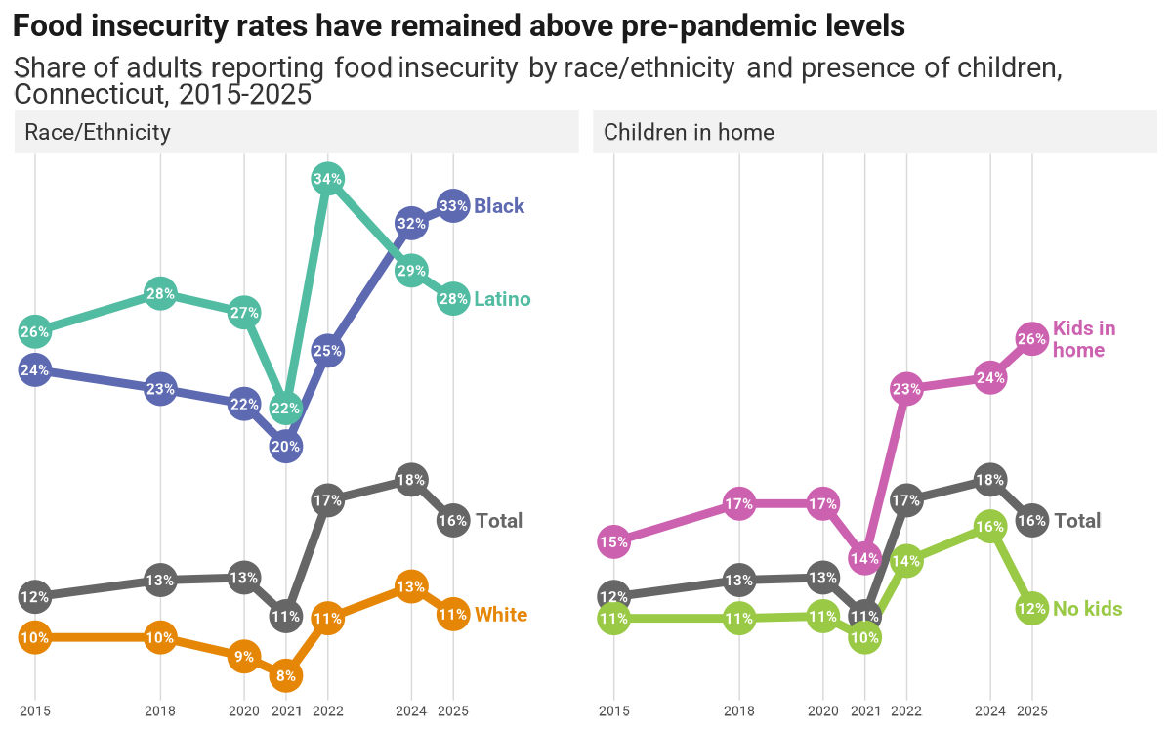
Services and support for children, youth, and families
According to the DataHaven Community Wellbeing Survey, food insecurity has risen to an all-time high among families with children.
In Waterbury, 40% of families with children ran out of money for food last year, compared to 26% of adults with children in the state as a whole
Source: DataHaven Community Wellbeing Survey, individual year estimates from 2015 to 2025

Slide 25
Mental health and substance use
Mental health and addiction crisis
Depression and anxiety tied to unaffordable rent, food, lack of care, and to loneliness
Long waits and too few providers; program mismatches; stigma in immigrant communities and communities of color
Highly visible drug use and overdoses; youth tobacco and vaping
People leaving incarceration struggle to find work, acceptance, and relapse
“if someone lives by themselves in a rented room, and they get depressed, a pill is not going to help that. They need community, and love, and care.”
“...if you are working hard but can’t meet your basic needs, of course your mental health will collapse.”

Slide 26
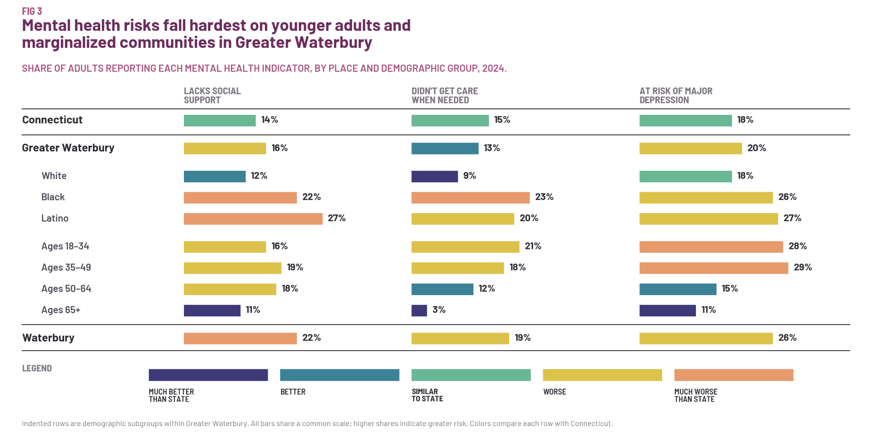
Mental health and substance use
Source: 2024 DataHaven Community Wellbeing Survey

Slide 27
Additional health needs intensify barriers
Older adults and disabilities
Fixed incomes squeezed by rising rent, utilities, and new medication copays
Isolation: many lack nearby family or are unsure where to turn for help
The digital divide cuts seniors off from information about benefits and services
Getting around and finding accessible care and housing is especially hard
“A lot of elderly [people] are being forgotten.”
“There are no rides for me to take [from Naugatuck to Trumbull to get to my medical appointment]. I can’t take anything unless I pay for it.”

Slide 28

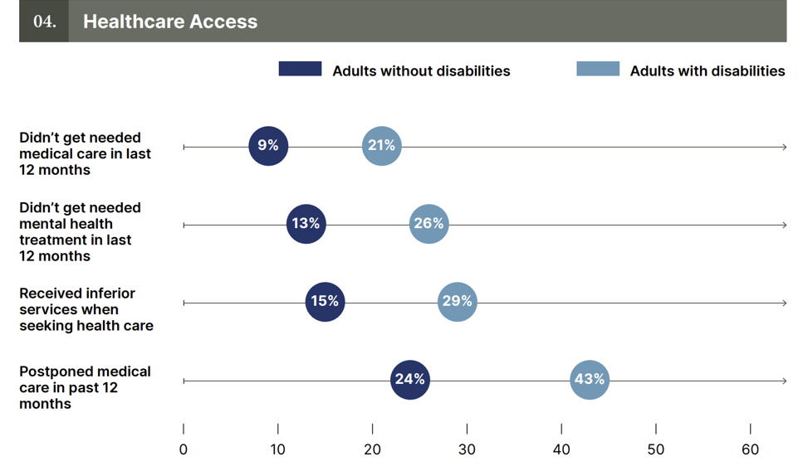
Older adults and disabilities
Source: DataHaven (2026), Disability in Connecticut, available at ctdatahaven.org

Slide 29
Public Comment

Slide 30
9:00a - 9:30a Breakfast & networking
9:30a - 10:20a Hospital updates & presentation of findings
10:20a - 10:50a Interactive gallery walk
10:50a - 11:00a Announcements & transition to breakouts
11:00a - 12:00p Breakout sessions
12:00p End of session - Safe travels!
Today’s agenda

Slide 31
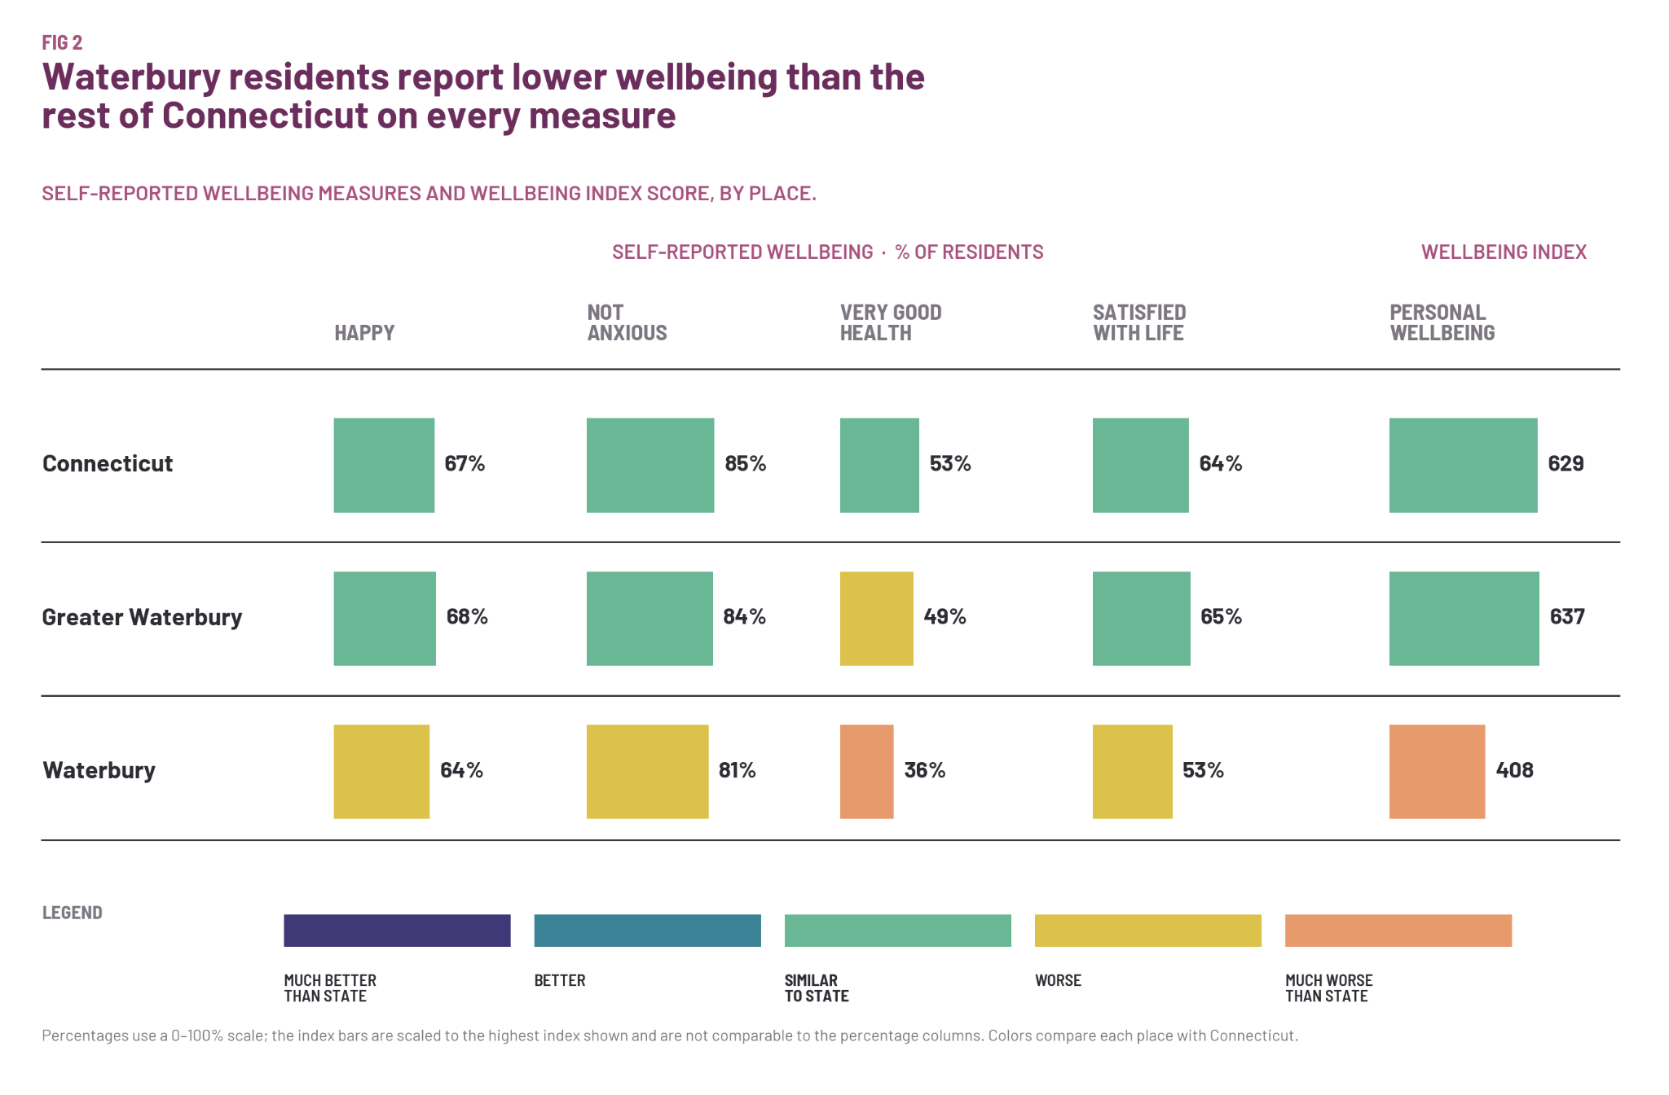
Example of Quantitative Data - Life Satisfaction
Measures of life satisfaction and self-rated health are lower in Waterbury than the region
For example, 36% of Waterbury adults report being in very good or excellent health, compared to 53% of adults statewide
Source: 2024 DataHaven Community Wellbeing Survey

Slide 32
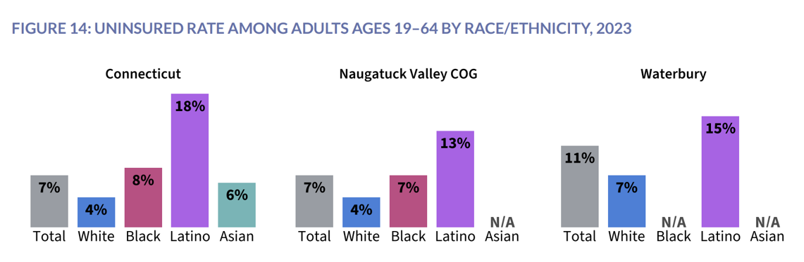
Access to high-quality, affordable health care
In the 2024 DataHaven Community Wellbeing Survey, 1 in 3 Waterbury adults didn’t get or postponed the care they needed in the past year.
Not being able to get an appointment, being too busy, and being concerned about cost were the top reasons why.
Source: DataHaven (2026), Waterbury Town Equity Report, available at ctdatahaven.org

Slide 33
Equity, discrimination, immigration, and language access
Identity impacts access
There are higher barriers to care for marginalized residents
Historically disinvested neighborhoods get less service
Language and interpretation gap
Immigration status-related fear keeps prevent access to care
“[S]he needed to give the child a pill ‘once’ per day. In English. But ‘once’ in Spanish means ‘eleven’. That mother gave her child 11 pills and it was a terrible situation.”
“People that don’t have work authorization – that’s a barrier, too... you’re at a high risk of losing [work] or... running the risk of someone taking advantage of you.”

Slide 34
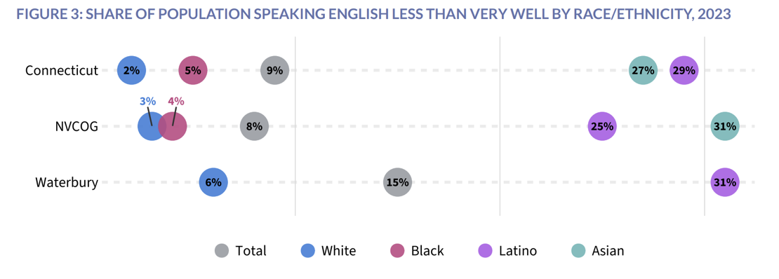
Equity, discrimination, immigration, and language access
In the 2024 DataHaven Community Wellbeing Survey, 22% of Waterbury adults (including 33% of Black adults) said they had faced discrimination when seeking health care, compared to 16% of adults statewide
Source: DataHaven (2026), Waterbury Town Equity Report, available at ctdatahaven.org

Slide 35
Housing is scarce and unaffordable
Affordable, stable housing and homelessness
Rents up from ~$800 to $1,500–$2,000; repeated hikes, deposits and fees, landlords dropping Section 8
Severe shortage of affordable and senior housing, with waitlists measured in years
Homeownership feels out of reach for young adults
Poor housing quality; shelters full, hard to access, or in poor condition
“There are a lot of people facing eviction right now, and there’s not enough affordable housing.”
“If I didn’t have a support system, I would be living on the street.”

Slide 36
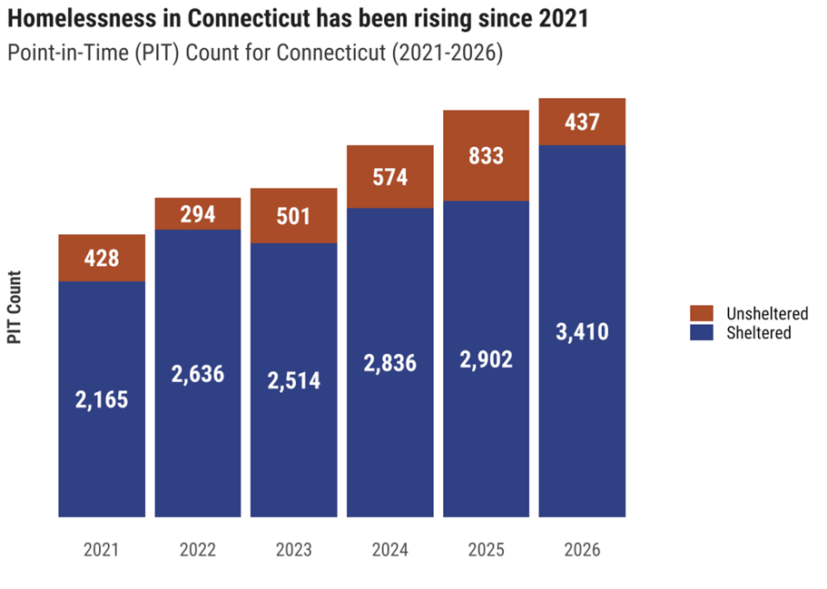
Affordable, stable housing and homelessness
According to the DataHaven Community Wellbeing Survey, the share of adults in the Greater Waterbury region who ran out of money to pay for housing in the past year has doubled (from 6% in 2015 to 12% in 2024)

Slide 37
Unreliable transit creates barriers
Transportation access and quality
Infrequent buses and long trips without a car
Medical rides unreliable, slow to schedule, and stressful
Loss of the hospital’s “Be Well Bus” hit seniors hard
Missing or unshoveled sidewalks, poor lighting, and steep hills make walking unsafe
“...in Waterbury you realize it’s a 30 minute drive, but it’s 3 hours with public transportation.”

Slide 38
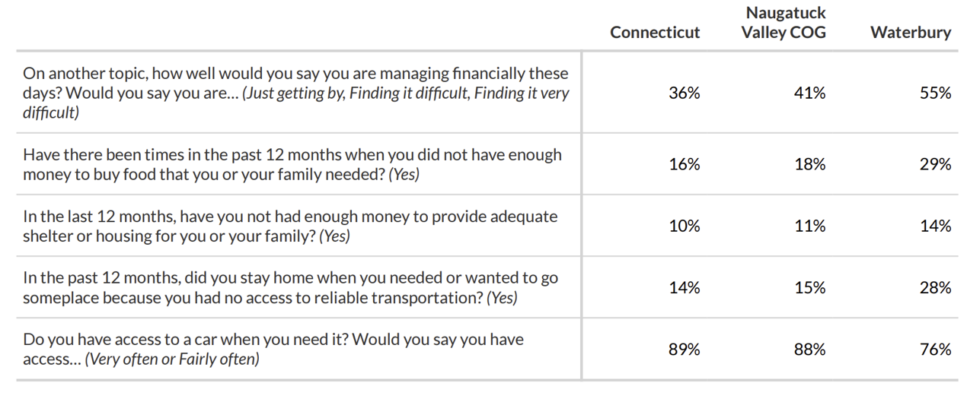
Transportation access and quality
Source: 2015-2024 DataHaven Community Wellbeing Survey MRP Estimates, published in DataHaven (2026), Naugatuck Valley COG Equity Report, available at ctdatahaven.org

Slide 39
Information, communication, and health literacy
It is difficult to find needed resources
Valuable programs go unused simply because people don’t know about them; outreach is limited
It is confusing to navigate services and to move between health systems
Literacy and self-advocacy gaps
Those with more education, time, and language access are served more easily
“There are services available to the community that people have no idea exist. I found out that there was a senior shuttle after I hurt my foot.”
“The problem is the lack of knowledge of the computer to find out what is out there for them.”

Slide 40
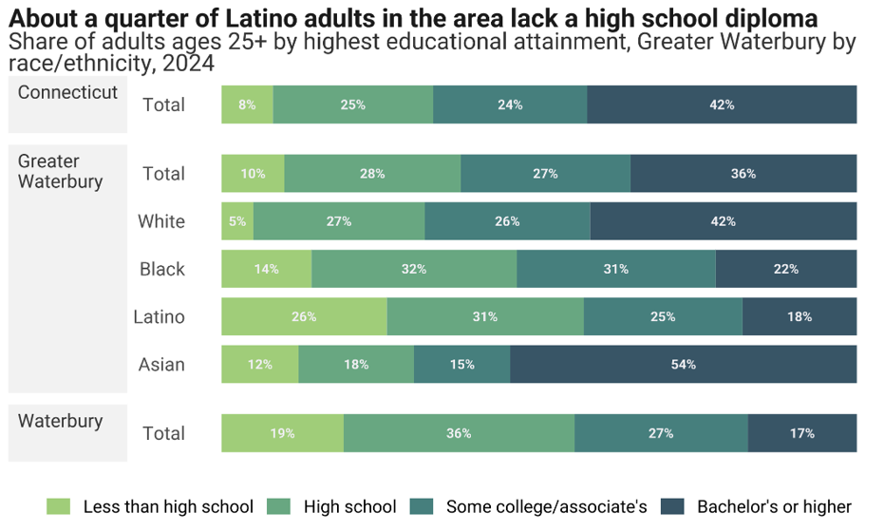
Information, communication, and health literacy
In the 2024 DataHaven Community Wellbeing Survey, many Waterbury residents who didn’t get the mental health treatment they needed said that “not knowing where to go” was the main reason
Source: DataHaven (2026), Waterbury Town Equity Report, available at ctdatahaven.org

Slide 41
Other issues
Participants shared additional thoughts
Veterans sometimes unhoused, isolated, or unsure how to navigate referrals and the VA
Too few social places to gather and to exercise
Screen and social media addiction, especially among young people
Frustration with government responsiveness, and a wish to be heard
“Everyone is on their phones. Nobody is talking to anyone.”
“It’s good to get this off my chest.”

Slide 42
Resources exist across Waterbury
Community assets
Care that works
Trusted people
Organizations & gathering places
Meeting basic needs
Community strengths
“I now have a Latina doctor... She speaks to me in Spanish. She makes me feel heard and seen.”
“The staff were all wonderful for me. They all listened to my concerns and I had a positive experience.”

